Slide 1
RESTler: Stateful REST API Fuzzing
41st ACM/IEEE International Conference on Software Engineering
25 May – 31 May, Montréal, QC, Canada
Vaggelis Atlidakis
Columbia University
Patrice Godefroid
Microsoft Research
Marina Polishchuk
Microsoft Research
Shared by: Jingtang Zhang @2019.09

Slide 2
REST ?
Representational State Transfer (REST): by Dr. Roy Thomas Fielding (2000)
A web software architecture style
Simple for transferring information between different programs through network
Based on HTTP

Slide 3
REST ?
Resource – URI
Operation (CRUD) – HTTP
Create – HTTP POST
Read – HTTP GET
Update – HTTP PUT
Delete – HTTP DELETE
Stateless, scalable, browser as client – platform independent

Slide 4
A REST Example
GitHub REST API v3
GET https://api.github.com/repos/:owner/:repo/contents/:path
POST https://api.github.com/repos/:owner/:repo/git/commits
PUT https://api.github.com/repos/:owner/:repo/topics
DELETE https://api.github.com/repos/:owner/:repo

Slide 5
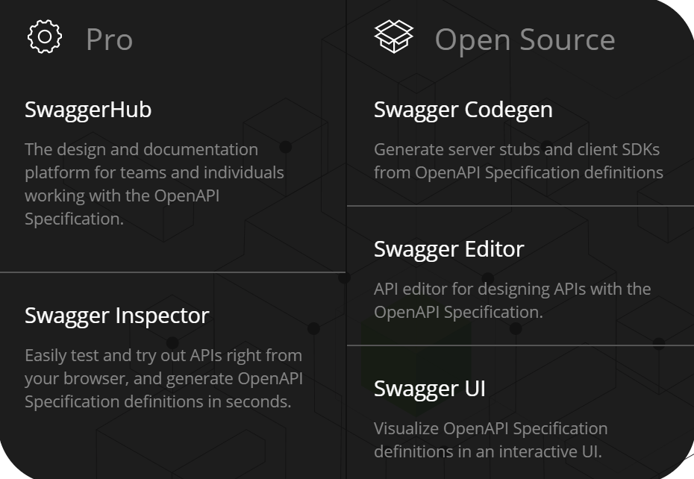
Swagger (OpenAPI)
A specification for machine-readable interface files
for describing, producing, consuming, and visualizing RESTful web services
JSON/YAML
Specification
Automated documentation
Code generation
Test-case generation

Slide 6
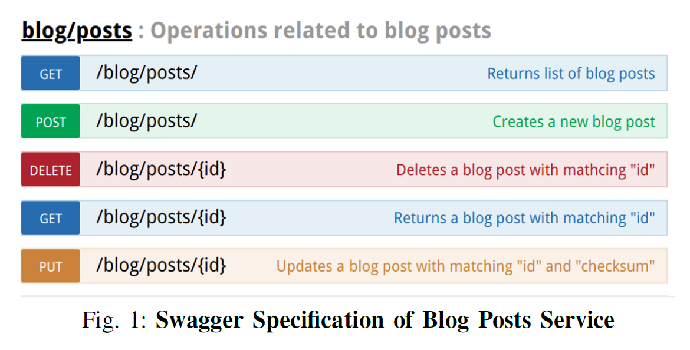
Swagger Example - blog
e.g. Specification
https://github.com/mrdrivingduck/paper-outline/blob/master/Web%20Security/RESTler%20-%20Stateful%20REST%20API%20Fuzzing/Outline%20-%20RESTler%20-%20Stateful%20REST%20API%20Fuzzing.md

Slide 7
Fuzzing RESTful Service
Fuzzing target: HTTP Response Code
{200} / {400} → Success
{500} / timeout → Server bugs

Slide 8

Stateful Fuzzing
Client
Old blog ID + SHA
New blog content
Blog content
Blog List
Blog ID
POST /blog/posts/
GET /blog/posts/
GET /blog/posts/{id}
PUT /blog/posts/{id}
New blog content
New SHA
Server
Blog content + SHA
Blogs
Blog content + SHA

Slide 9
Issues
Inferring dependences (type, value)
Validity – dynamic feedback
API search strategies

Slide 10
Solution
Inferring dependences (type, value)
PUT /blog/posts/{[int]}
GET /blog/posts
ID (integer)
PUT /blog/posts/{[string]}

Slide 11
Solution
2. Validity – dynamic feedback
REQ2
404
REQ6
200
REQ3
200
REQ1
200
REQ7
404
REQ4
404
REQ5
404

Slide 12
Solution
3. API search strategies
BFS
BFS-Fast
Random Walk

Slide 13
Algorithm
reqSet:
{ }
seqSet:
{
……
}
REQ1
REQ2
REQ3
REQ4
Inputs: swagger_spec, maxLength
reqSet = PROCESS(swagger_spec)
seqSet = {}
n = 1
while (n <= maxLength):
seqSet = EXTEND(seqSet, reqSet)
seqSet = RENDER(seqSet)
n = n + 1
REQ1
200
REQ2
200
REQ1
200
REQ3
200

Slide 14
Algorithm
def EXTEND(seqSet, reqSet):
newSeqSet = {}
for seq in seqSet:
for req in reqSet:
if DEPENDENCIES(seq, req):
newSeqSet = newSeqSet + concat(seq, req)
return newSeqSet
reqSet:
{ }
seqSet:
{
……
}
REQ1
REQ2
REQ3
REQ4
REQ1
200
REQ2
200
REQ1
200
REQ3
200

Slide 15
Algorithm
reqSet:
{ }
seqSet:
{
……
}
REQ1
REQ2
REQ3
REQ4
def DEPENDENCIES(seq, req):
if CONSUMES(req) ⊆ PRODUCES(seq):
return True
else:
return False
REQ1
200
REQ2
200
REQ1
200
REQ3
200
def CONSUMES(req):
return object_types_required_in(req)
def PRODUCES(seq):
dynamicObjects = {}
for req in seq:
newObjs = objects_produced_in_response_of(req)
dynamicObjects = dynamicObjects + newObjs
return dynamicObjects

Slide 16
Algorithm
reqSet:
{ }
seqSet:
{
……
}
REQ1
REQ2
REQ3
REQ4
Inputs: swagger_spec, maxLength
reqSet = PROCESS(swagger_spec)
seqSet = {}
n = 1
while (n <= maxLength):
seqSet = EXTEND(seqSet, reqSet)
seqSet = RENDER(seqSet)
n = n + 1
REQ1
200
REQ2
200
REQ4
?
REQ1
200
REQ3
200
REQ4
?

Slide 17
Algorithm
reqSet:
{ }
seqSet:
{
……
}
def RENDER(seqSet):
newSeqSet = {}
for seq in seqSet:
req = last_request_in(seq)
V = tuple_of_fuzzable_types_in(req)
for v in V:
newReq = concretize(req, v)
newSeq = concat(seq, newReq)
response = EXECUTE(newSeq)
if response has a valid code:
newSeqSet = newSeqSet + newSeq
else:
log error
return newSeqSet
REQ1
REQ2
REQ3
REQ4
REQ1
200
REQ2
200
REQ4
200
REQ1
200
REQ3
200
REQ4
404

Slide 18
API Search Strategies
reqSet:
{ }
seqSet:
{
……
}
Default: BFS
Combination explode
REQ1
REQ2
REQ3
REQ4
REQ1
200
REQ2
200
REQ1
200
REQ3
200

Slide 19
API Search Strategies
reqSet:
{ }
seqSet:
{
……
}
BFS-Fast
A smaller set newSeqSet
Cover every request
Do not generate all valid request sequences
REQ1
REQ2
REQ3
REQ4
REQ1
200
REQ2
200
REQ1
200
REQ3
200
Every request is appended to at most one sequence

Slide 20
API Search Strategies
reqSet:
{ }
seqSet:
{
……
}
Random Walk
Randomly selecting one request in seqSet
Randomly selecting one request in reqSet
Until all the dependencies of that pair are satisfied
Restart
REQ1
REQ2
REQ3
REQ4
REQ1
200
REQ2
200
REQ1
200
REQ3
200

Slide 21
Evaluation
Inferring Dependencies & Analyzing Dynamic Feedback Necessary?
if (oldChecksum == postChecksum) {
throw exception();
}

Slide 22
Evaluation
Inferring Dependencies & Analyzing Dynamic Feedback Necessary?
Configuration
❌Inferring Dependencies; ✔ Analyzing dynamic feedback
✔Inferring Dependencies; ✖Analyzing dynamic feedback
✔Inferring Dependencies; ✔Analyzing dynamic feedback

Slide 23
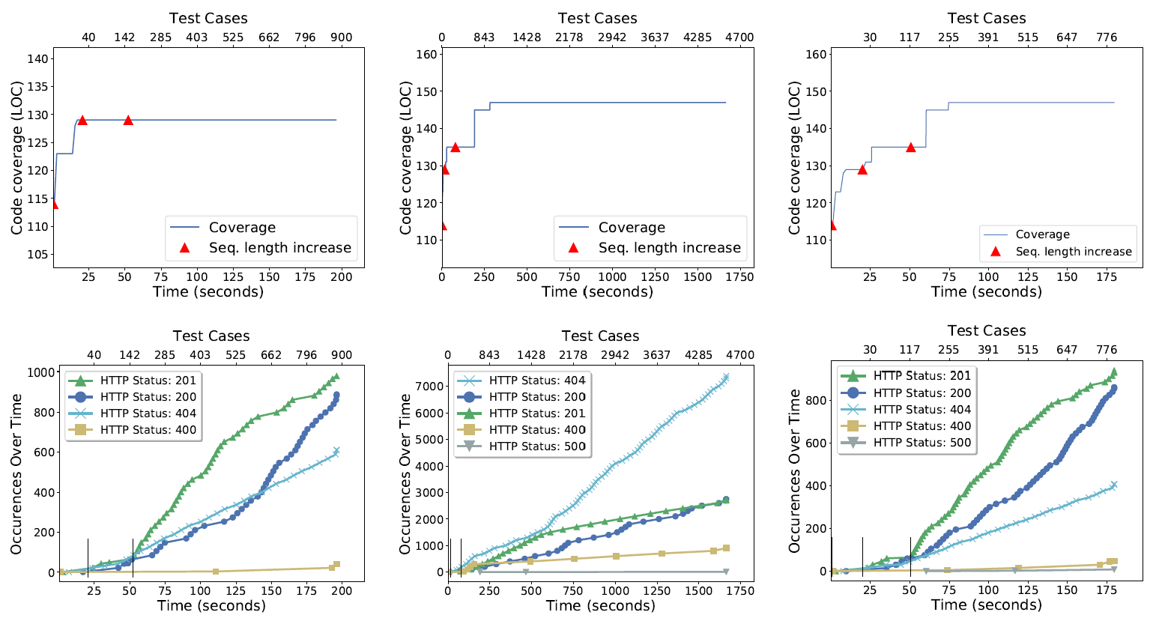
Evaluation
Inferring Dependencies & Analyzing Dynamic Feedback Necessary?
Coverage
HTTP response validity
Time

Slide 24
Evaluation
Inferring Dependencies & Analyzing Dynamic Feedback Necessary?
More coverage – more server-side logic
More valid HTTP response – efficiency
Less time - efficiency
Necessary

Slide 25
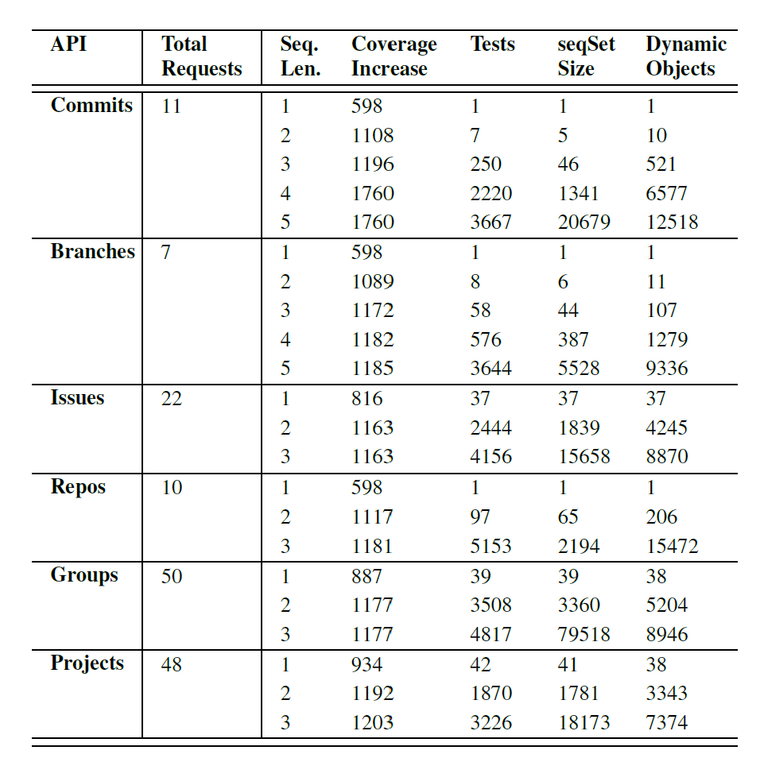
Evaluation
Sequence length increases →? Deeper server-side logic
GitLab: 5-hour-fuzzing
Some of the service functionality can only be exercised after at least a few requests are executed
BFS – seqSet grow quickly (even worse without two tech.)

Slide 26
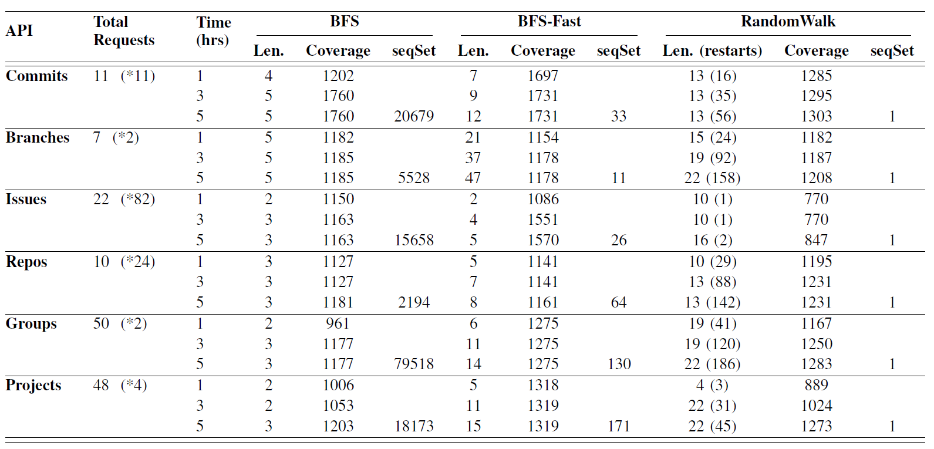
Evaluation
Search strategies

Slide 27
Thanks.
RESTler: Stateful REST API Fuzzing
Shared by: Jingtang Zhang @2019.09

